Slide 1
FAKE CURRENCY PREDICTION
Bhargav M
Sai Krish
Anjali Krishnan L
Dhanraj

Slide 2
Agenda
Introduction
Problem Statement
Objectives
Proposed System
Experimental Evaluation

Slide 3
Introduction
Welcome to our comprehensive project on Fake Currency Detection, a robust system designed to combat counterfeit money. Utilizing advanced machine learning this project aims to accurately identify forged banknotes, safeguarding financial systems and businesses. Through meticulous analysis of key security features like variance, skewness, entropy, and kurtosis.
Our solution ensures reliable and swift detection, contributing to maintaining the integrity of currency circulation. Join us on this innovative journey to safeguard economies against fraudulent activities, fostering trust and security in financial transactions.

Slide 4
PROBLEM STATEMET
The project aims to develop a robust system for detecting counterfeit currency notes using machine learning algorithms. With the prevalence of fake currency circulation, this system becomes crucial for financial institutions and businesses to authenticate cash transactions accurately. The project involves gathering a dataset comprising genuine and counterfeit currency images, extracting meaningful features, and employing classification models like neural networks or support vector machines to differentiate between authentic and forged notes. The system's success relies on its ability to accurately identify intricate patterns and security features unique to genuine currency, while also adapting to newer counterfeit techniques. Ultimately, the project seeks to provide a reliable, automated solution to safeguard against financial fraud and maintain the integrity of currency transactions in the market.

Slide 5
OBJECTIVES
Accuracy Improvement
Real-time Detection
User-Friendly Interface
Deployment Optimization

Slide 6
Technology used and Its Characteristics
JUPYTER NOTEBOOK
SUBLIME TEXT
STREAMLIT
GitHub

Slide 7
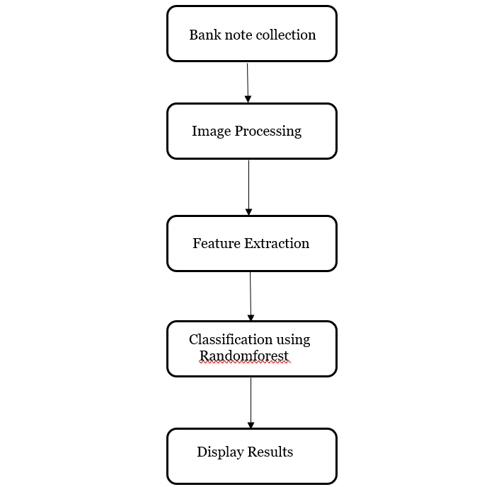
PROPOSED SYSTEM

Slide 8
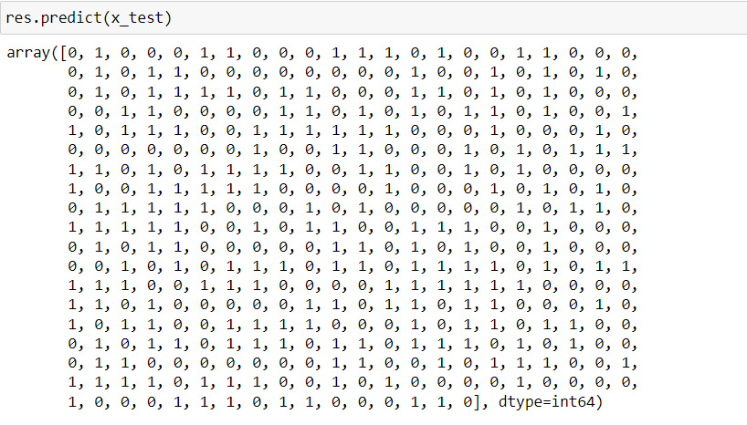
EXPERIMENTAL EVALUATIONS
Results of test data

Slide 9
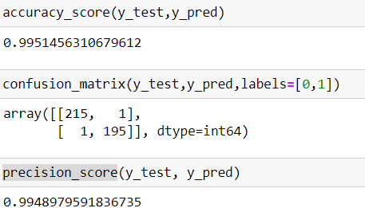
EXPERIMENTAL EVALUATIONS
Accuracy score, Confusion matrix and precision score

Slide 10
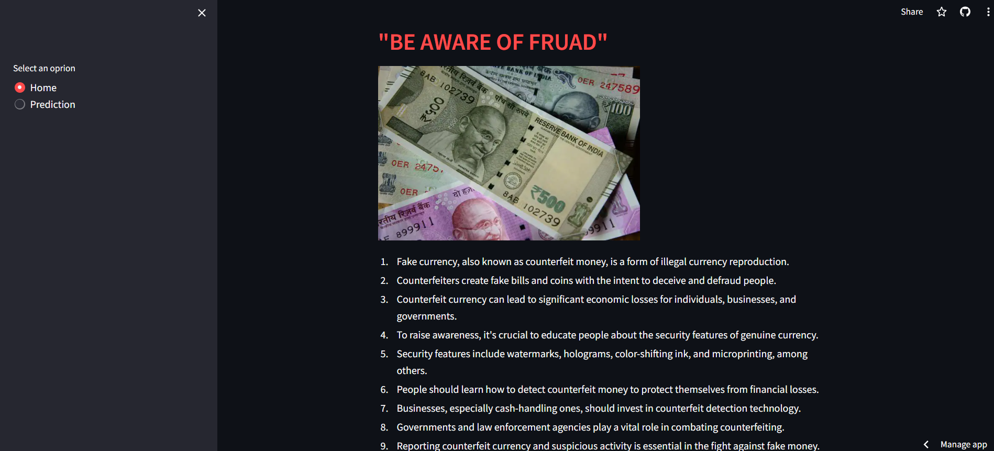
EXPERIMENTAL EVALUATIONS
First page of streamlit App

Slide 11
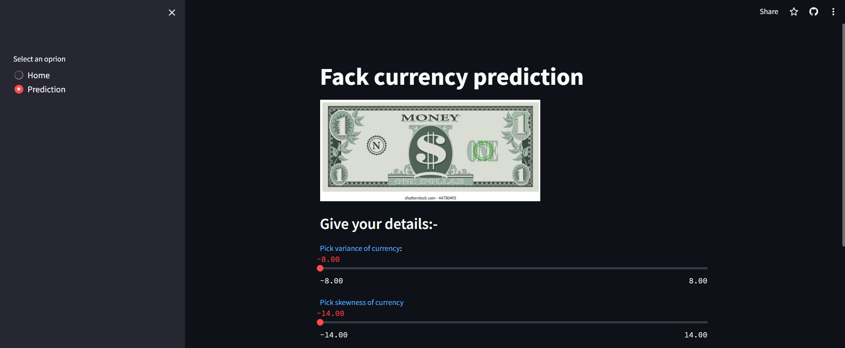

EXPERIMENTAL EVALUATIONS
Prediction page of streamlit App

Slide 12

EXPERIMENTAL EVALUATIONS
TRUE Prediction

Slide 13

EXPERIMENTAL EVALUATIONS
FALSE Prediction

Slide 14
Thank you
Bhagavvishwa2002@gamil.com
saikris2k3@gmail.com
dhanrajmankar0@gmail.com
anjalikrish2003@gmail.com

